Slide 1
JAVA Lecture 17
Enumerations in JAVA

Slide 2
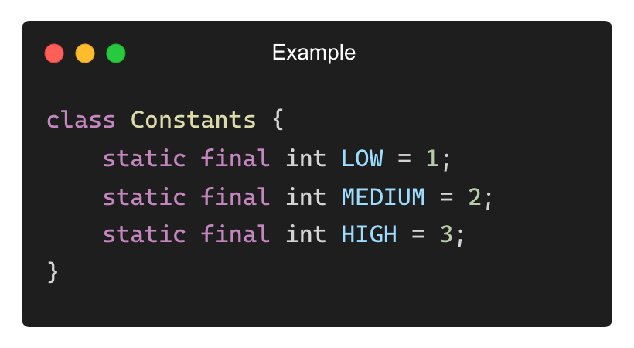
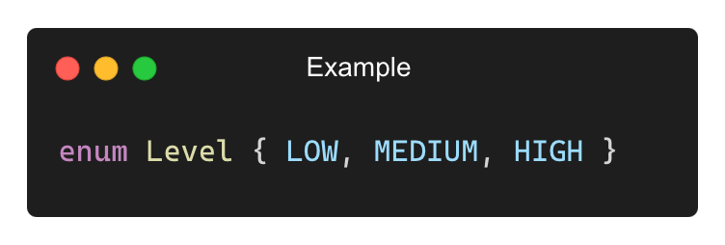
What is an Enumeration (enum) in Java?
An enumeration is a special class that represents a group of constants.
Why use enums?
✅ Improves code readability and type safety.
✅ Replaces integer constants (final static).
✅ Ensures only predefined values can be used.
Example of Constants Without Enums (Less Readable):
Using an Enum (Better Approach):

Slide 3
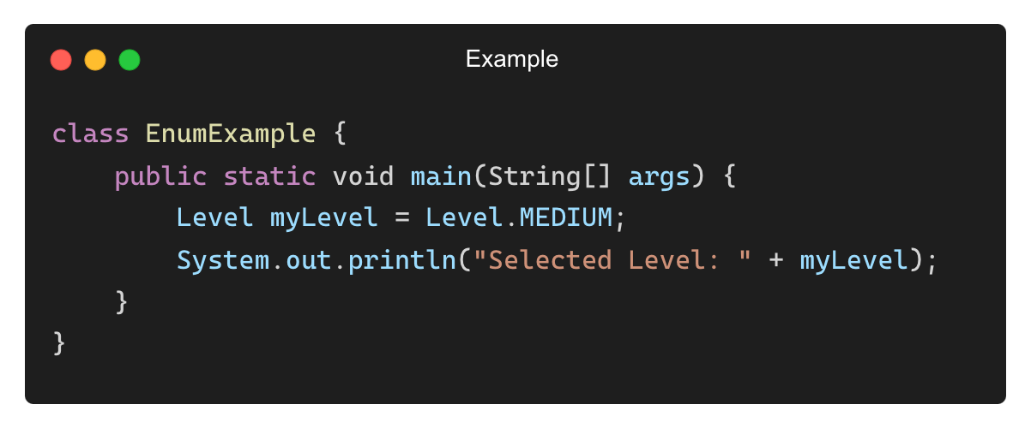
Defining and Using an Enum
Syntax:
Example Usage:
✅ Safer and more readable than using integer constants.

Slide 4
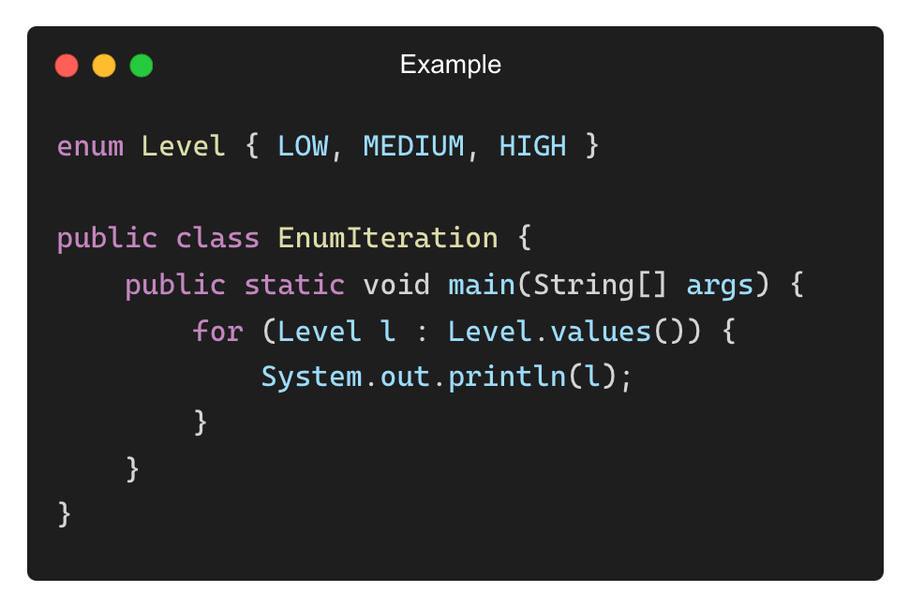
Accessing Enum Constants
Each constant in an enum is a public, static, final member.
Example: Print all enum constants:
Output:
LOW
MEDIUM
HIGH
✅ values() returns an array of all enum constants.

Slide 5
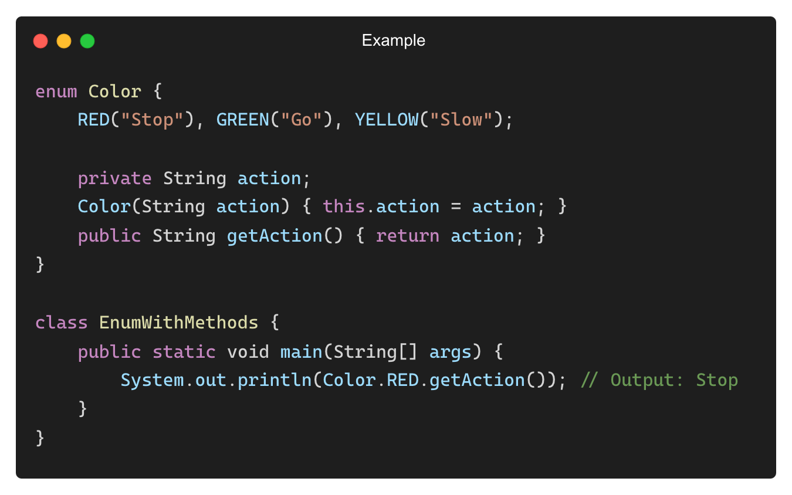
Enum with Constructors and Methods
Enums can have constructors, methods, and instance variables.
✅ Allows enums to store additional data.

Slide 6
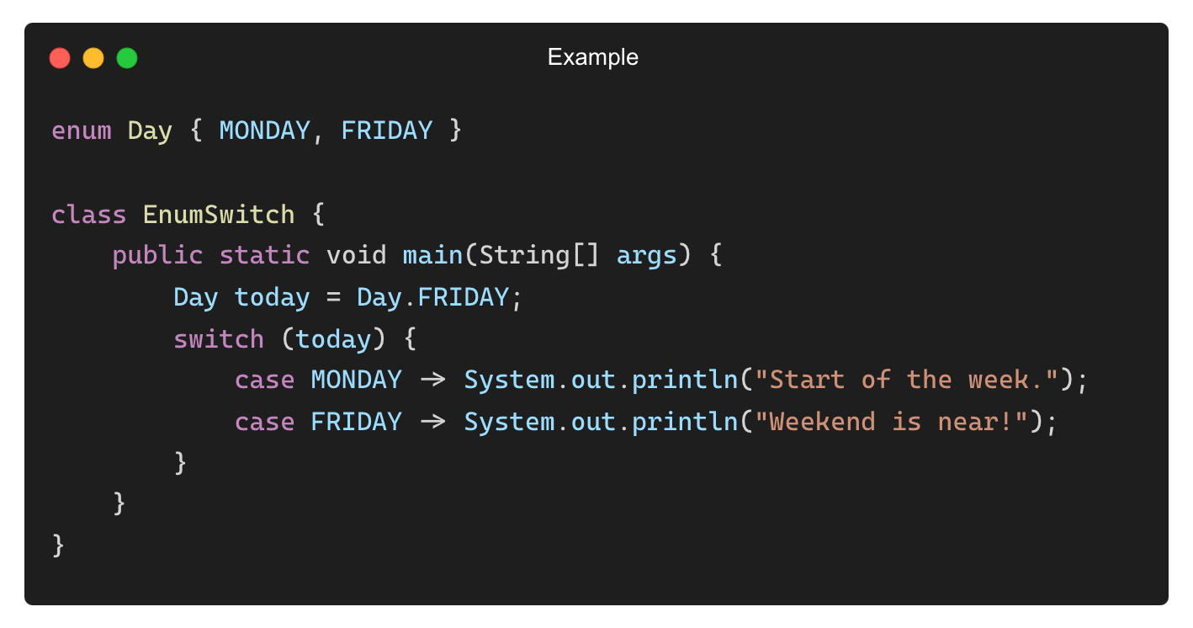
Using switch with Enums
switch works seamlessly with enums.
✅ Prevents invalid cases, making the code more robust.

Slide 7
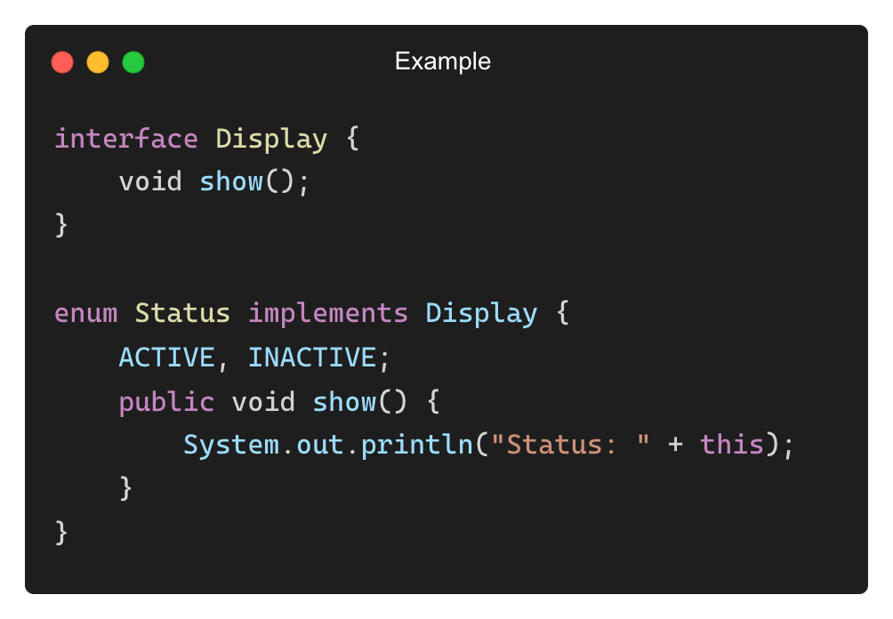
Enum Implementing an Interface
Enums can implement interfaces but cannot extend classes.
✅ Enums can contain business logic while remaining type-safe.

Slide 8
What are values() and valueOf() in Enums?
• Enums provide built-in methods for accessing constants dynamically.
• values() Method: Returns an array of all enum constants.
• valueOf(String name) Method: Converts a string into an enum constant.
• Why use these methods?
✅ Allows iteration over enum constants dynamically.
✅ Enables converting user input into an enum constant.
✅ Helps maintain type safety in applications.

Slide 9
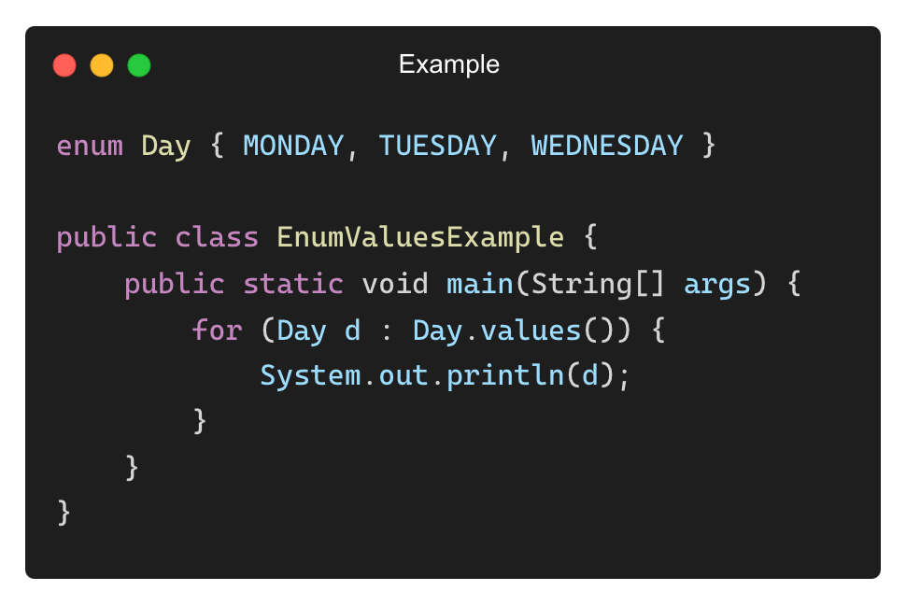
Using values() to List All Enum Constants
The values() method returns all enum constants as an array.
Output:
MONDAY
TUESDAY
WEDNESDAY
✅ Great for displaying all possible options in a menu or list.

Slide 10
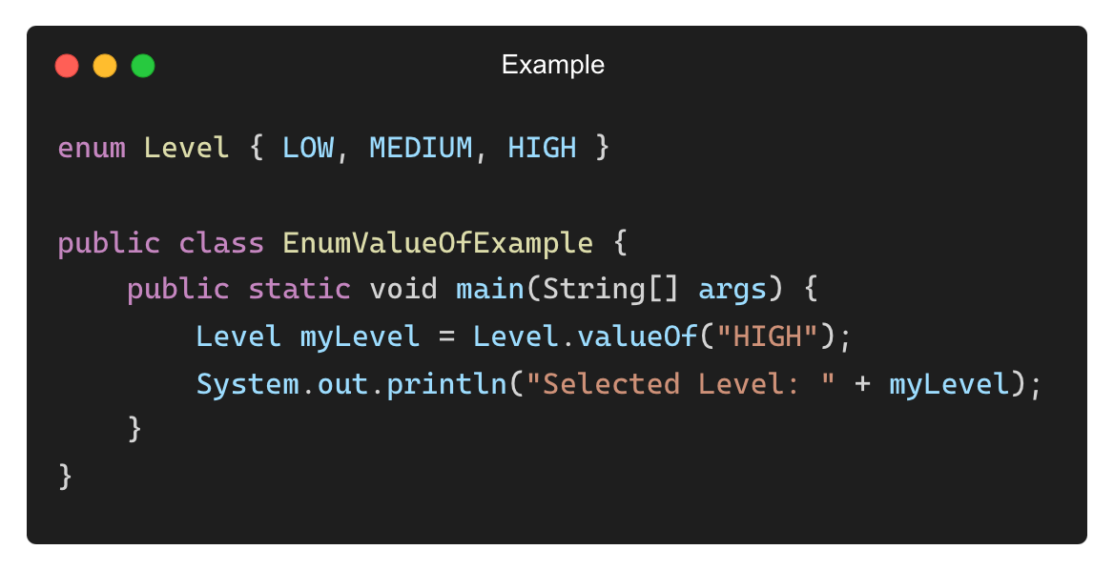
Using valueOf() to Convert a String to an Enum
The valueOf(String name) method converts a string to an enum constant.
Output:
Selected Level: HIGH
✅ Ensures type safety instead of using raw strings.

Slide 11
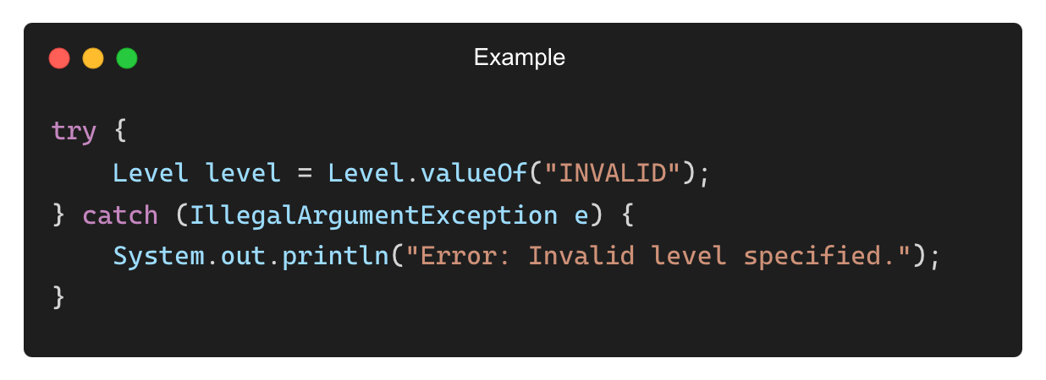
Handling Invalid valueOf() Conversions
valueOf() throws IllegalArgumentException if the value doesn’t match any enum constant.
Output:
Error: Invalid level specified.
✅ Always validate user input before converting to an enum.

Slide 12
THANK YOU

